Slide 1

G2M Case Study
Virtual Internship
13-Feb-2022

Slide 2
Background –G2M(cab industry) case study
XYZ is a private equity firm in US. Due to remarkable growth in the Cab Industry in last few years and multiple key players in the market, it is planning for an investment in Cab industry.
Objective : Provide actionable insights to help XYZ firm in identifying the right company for making investment.
The analysis has been divided into four parts:
Data Understanding
Forecasting profit and number of rides for each cab type
Finding the most profitable Cab company
Recommendations for investment

Slide 3
Data Exploration
15 Features( including 4 derived features)
Timeframe of the data: 2016-01-31 to 2018-12-31
Total data points :355,032
Assumptions:
Outliers are present in profit feature(using IQR)
Margin are calculated keeping other factors constant and only
Price_Charged and Cost_of_Trip features used to calculate profit.
Gender, Company, payment method are transformed to binary(0,1)
Date are change to a normal format
Cab_Data.csv
Customer_ID.csv
Transaction_ID.csv
City.csv
USholiday.csv
Final cab data

Slide 4
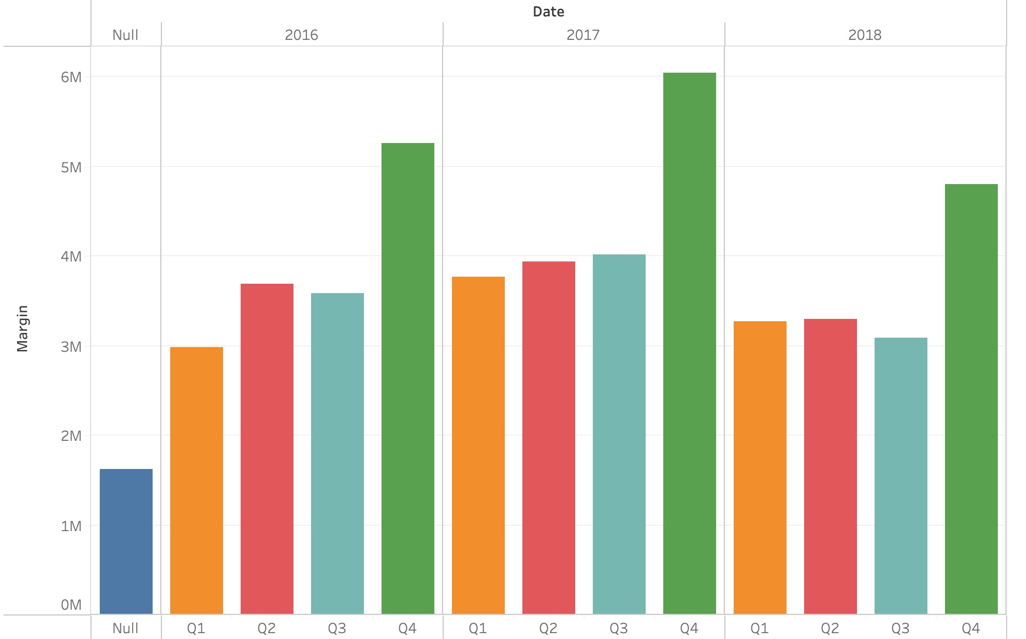
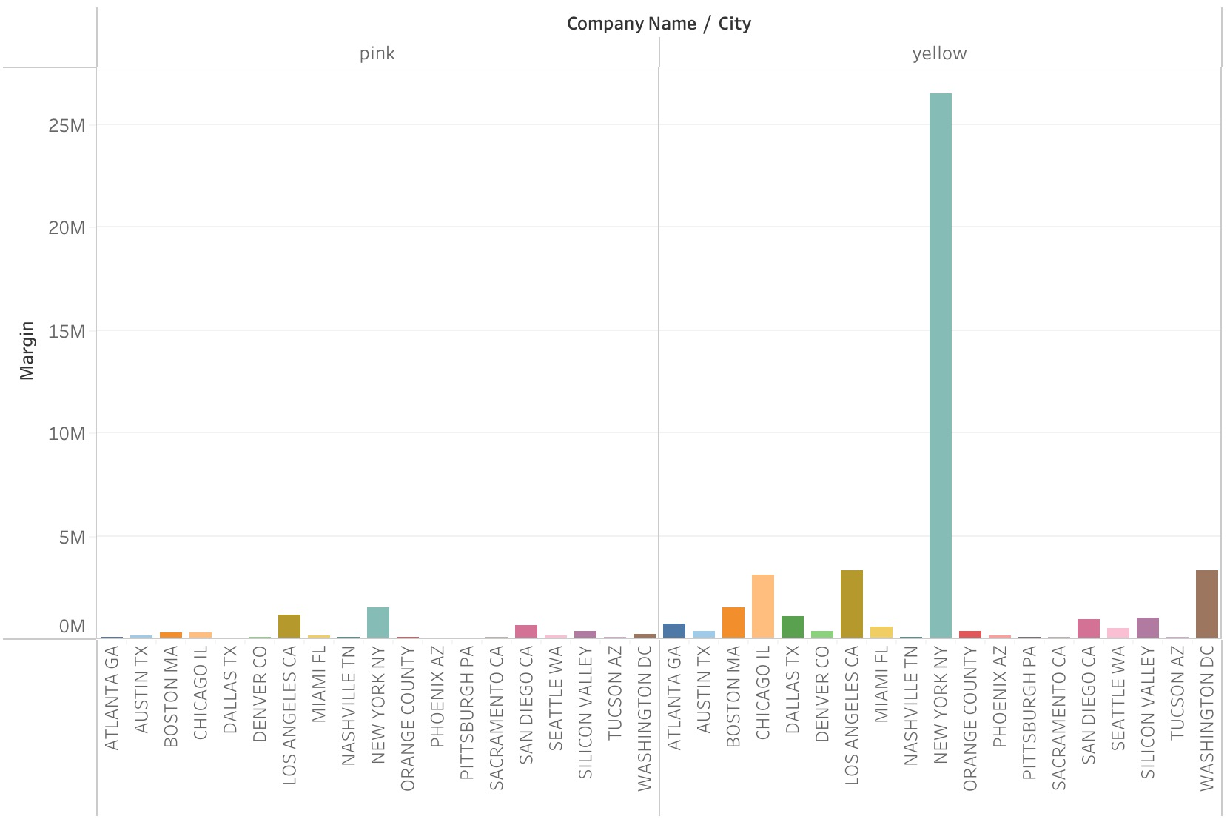
Profit Analysis
Profit Analysis by City and Company

Slide 5
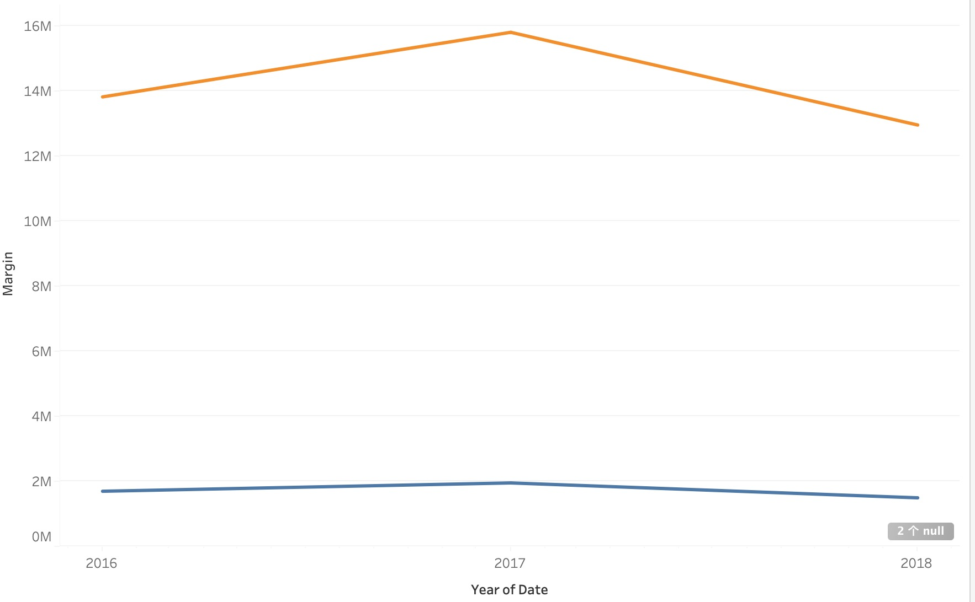
Yearly Profit Analysis

Slide 6
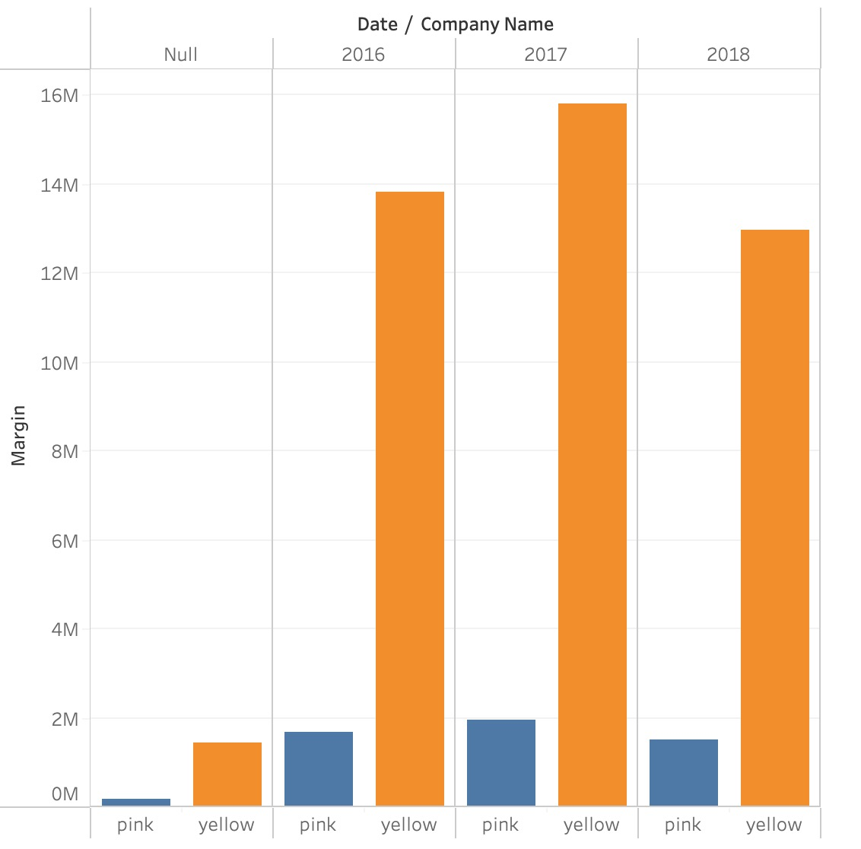
Profit in Different Time Zone
Q4 is the busy season

Slide 7
Income Class wise Profit and customer base Analysis
Middle class and high class contributes more in the profit as well as in the customer base of both the cabs

Slide 8
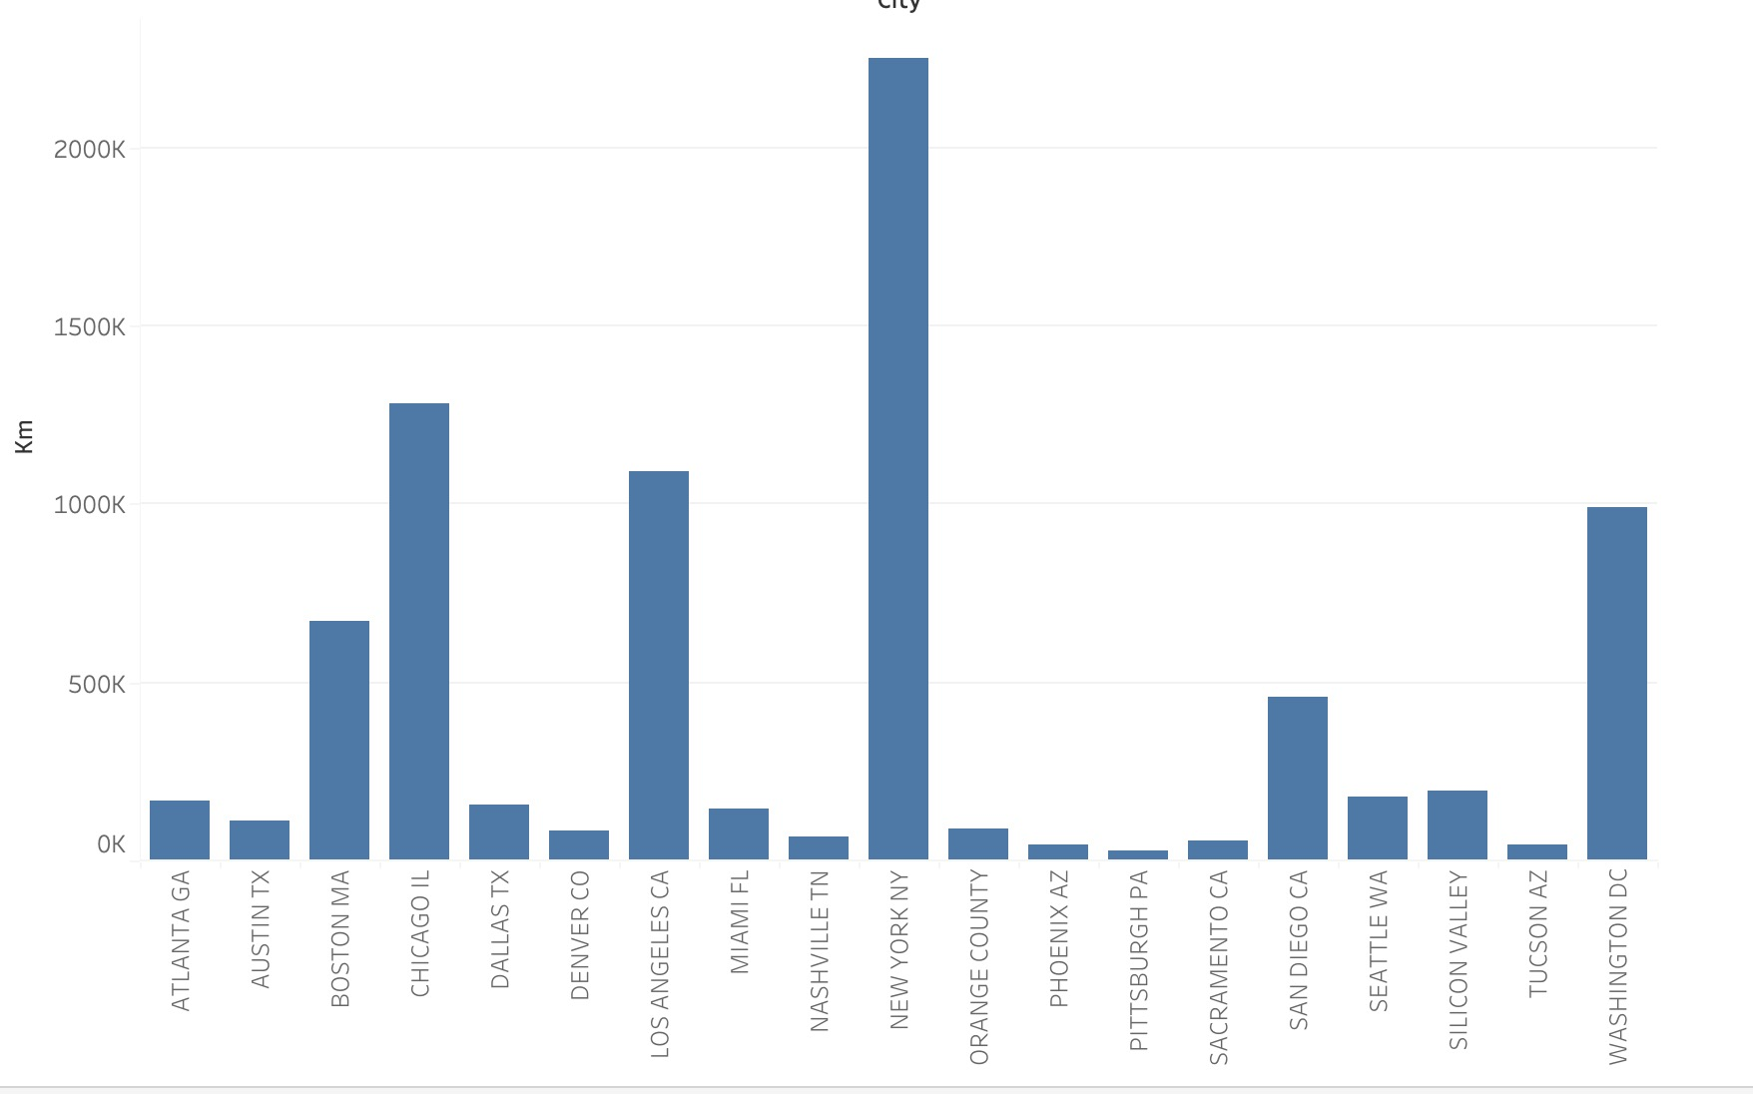
Travelling Distance in Different City

Slide 9
City Wise Cab Users Covered By Company
This is the number
of users covered by
Yellow and Pink cab
In the city against
all cab users present
In the city

Slide 10
Customer Presence of Yellow and Pink cab city wise
Out of 19 Cities Pink cab have higher customer reach as compared to Yellow cab ,in following 4 cities:
SanDiego
Nashville
Sacramento
Pittsburgh

Slide 11
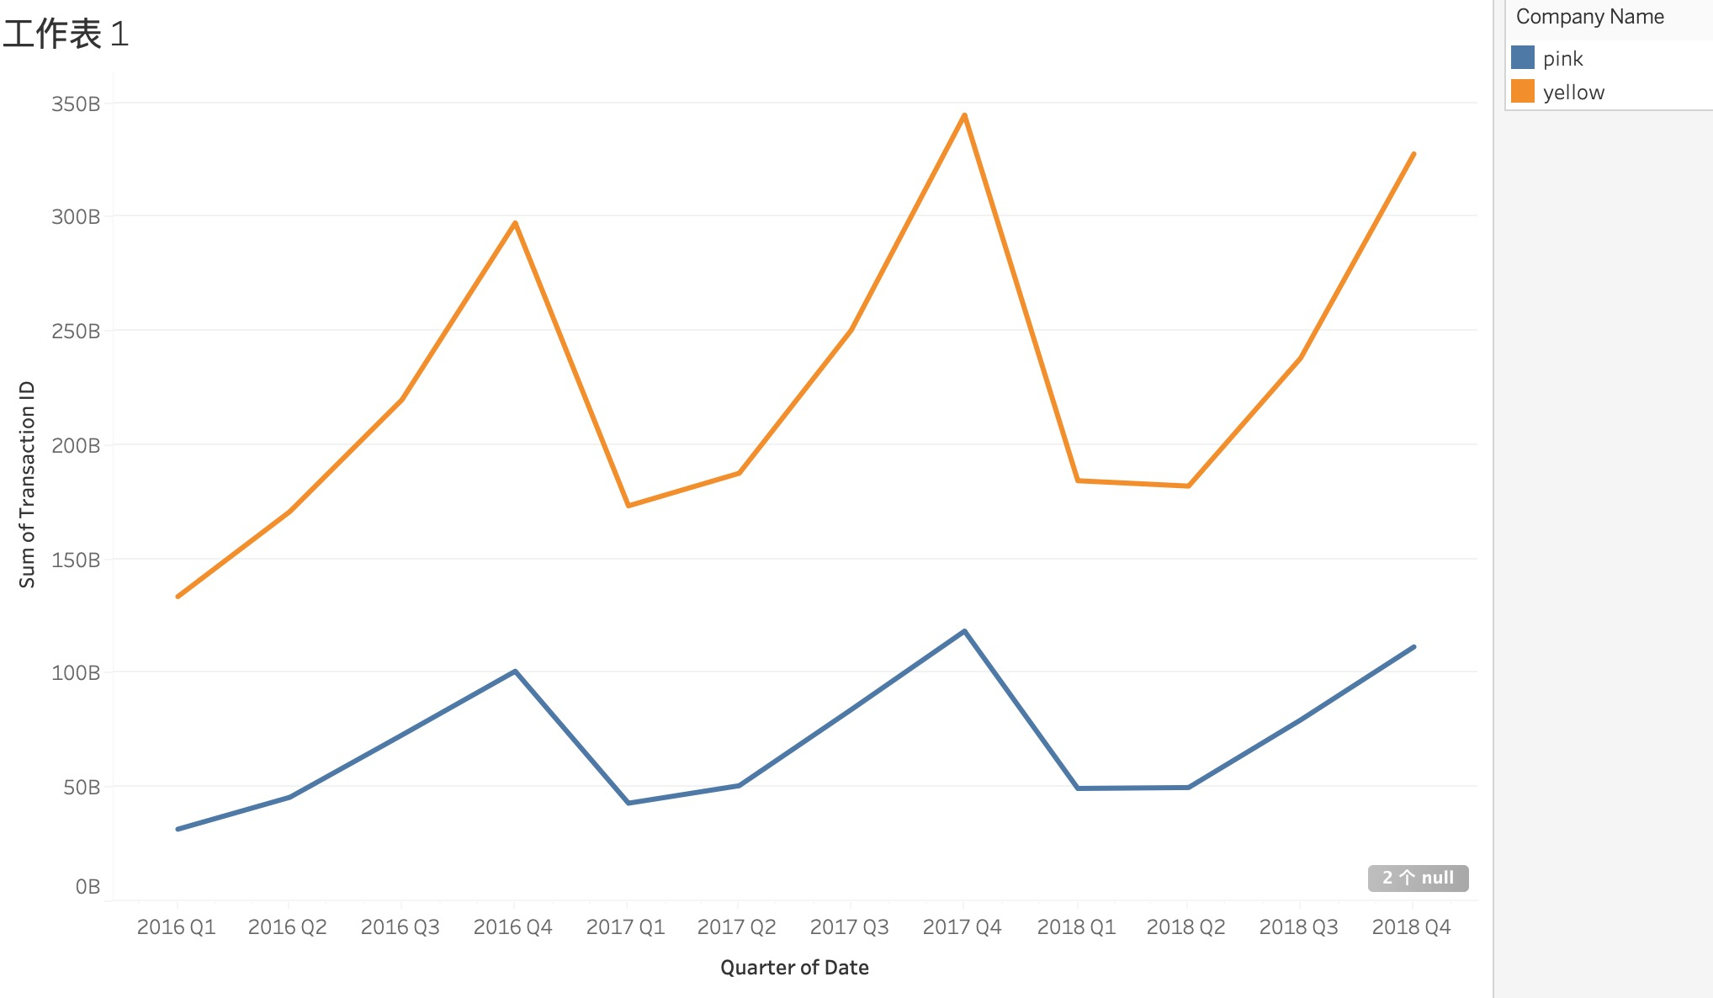
Seasonality in the demand
Seasonal component is present in
both the cabs.
Demand is high on 3rd day of the
month and it repeats similar
pattern every 7 days

Slide 12
Customer analysis based on ride distance
Yellow cab has customers
almost uniform
for short, medium and long
Trip. Which shows yellow cab
is offering better customer
plan for short, medium and
long Trip.
5-35 KM trips are contributing
more In both the cabs profit
There is a huge difference between yellow and pink cab in customer reach for short and long trip. Yellow cab has very good customer reach in this segment as well

Slide 13
Recommendations
We have evaluated both the cab companies on following points and found Yellow cab better than Pink cab:
Customer Reach : Yellow cab has higher customer reach in 25 cities while Pink cab has higher customer reach in 4 cities. We have also observed that Yellow cab is doing good in covering other cab users as compared to Pink cab.
Customer Retention: We have analyzed this in two segments : at least 5 drive and at least 10 drive with the same cab company. And we found that Yellow cab is doing far better than Pink cab in both these segments.
Age wise Reach : Yellow cab has customer in all age group and it’s been observed that it’s even popular in 60+ age group as equally as its in 18-25 age group.
Average Profit per KM: Yellow cab’s average profit per KM is almost three times the average profit per KM of the Pink cab.
Income wise Reach :Both the cabs are very popular in high and medium income class but here also Yellow cab is performing better than Pink cab in offering their services to all the three income class group (low, medium and high)
Ride count and Profit Forecasting : Both the companies are facing loss in the profit and no. of ride. Yellow cab’s forecasted profit loss is around 1.83% while Pink cab’s loss in 3.1%.Pink cab is facing more loss even when its forecasted no of ride loss is lesser than Yellow cab.
On the basis of above point , we will recommend Yellow cab for investment.

Slide 14
Thank You

